Slide 1
EMOTION CORRELATION MINING THROUGH DEEP LEARNING MODELS ON NATURAL LANGUAGE TEXT DOMAIN: DATA MINING
GUIDE:
Dr.T.JACKULIN,M.E.,Ph.D.,
Assistant Professor.
BATCH C13:
R.SWARNALASHMI
B.SNEHA
ZULAIHA FATHIMA.V.I

Slide 2
AGENDA
Introduction
Problem statement
Literature survey
Technology stack
System Architecture
System design
Detailed explanation of modules
Testing and Performance Analysis
Screenshots
Graph Comparison
Conclusion
Reference

Slide 3
INTRODUCTION
Emotion analysis has been attracting researcher’s attention. Most previous works in the artificial-intelligence field focus on recognizing emotion rather than mining the reason why emotions are not or wrongly recognized.
The correlation among emotions contributes to the failure of emotion recognition. In this article, we try to fill the gap between emotion recognition and emotion correlation mining through natural language text from Web news.
The CNN and Collaborative algorithm is used here. the given input data are tweets per-processed and then the classification is done and final results will be integrated such as the given number of title, emotion, hash tags, and commands will be collected and separately given as the output. The correlation among emotions contributes to the failure of emotion recognition.
The method is validated using three datasets: 1) the titles2) the bodies and 3) the comments of news articles, covering both objective and subjective texts in varying lengths
As an important traditional branch of knowledge mining, is categorized into three levels, namely: word level, sentence level, and document level.

Slide 4
PROBLEM STATEMENT
• The complexity is composed of two parts, that is, the diversity of emotions and the complexity of social events. The complexity of the problem will inevitably lead to errors without considering other factors.
• The emotion of individuals is complex and is impacted by individualized long-term social experiences, misunderstandings caused by prior background knowledge, and external instant mood influences.
• The application of the subjective and emotional data from social media includes but is not limited to sentiment analysis. The number of features in explicit expression is not less than that in implicit expression, as synonyms share the same tag in implicit expression

Slide 5
LITERATURE SURVEY

Slide 6
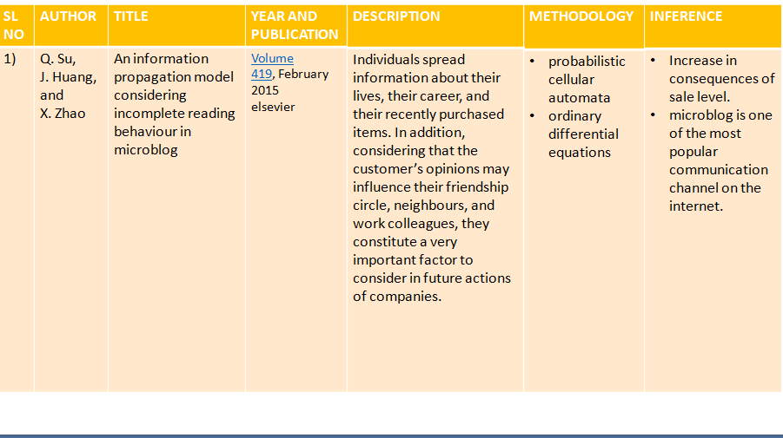

Slide 7
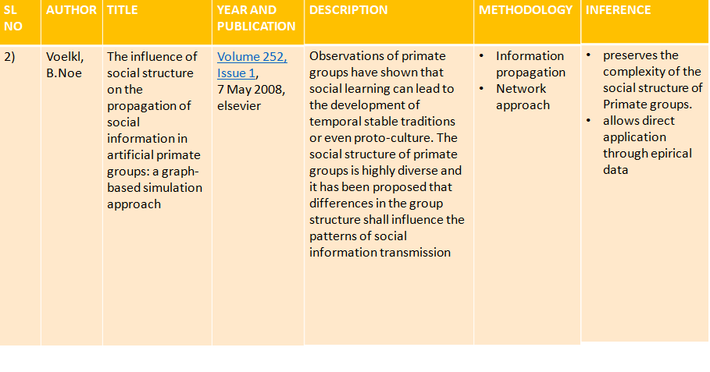

Slide 8
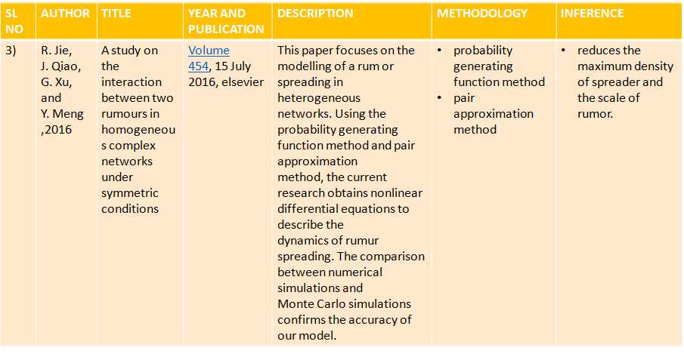

Slide 9
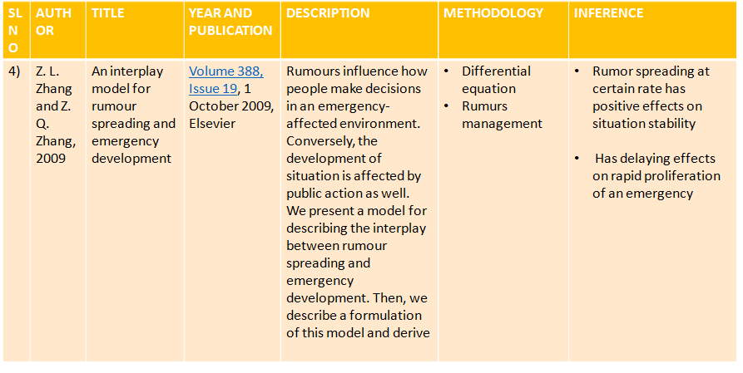

Slide 10
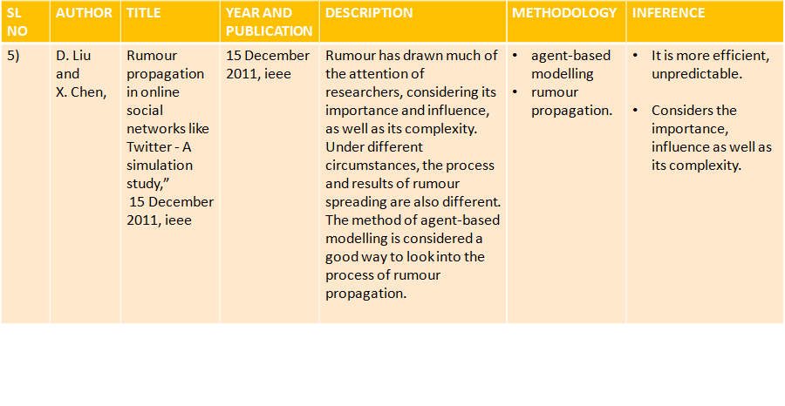

Slide 11
TECHNOLOGY STACK
HARDWARE REQUIREMENTS: SOFTWARE REQUIREMENTS:
• System : Pentium IV 2.4 GHz. • Operating system : Windows XP.
• Hard Disk : 40 GB. • Coding Language : JAVA
• Floppy Drive : 1.44 Mb • Data Base : MYSQL
• Monitor : 15 VGA Colour
• Mouse : Logitech.
• Ram : 512 Mb.

Slide 12

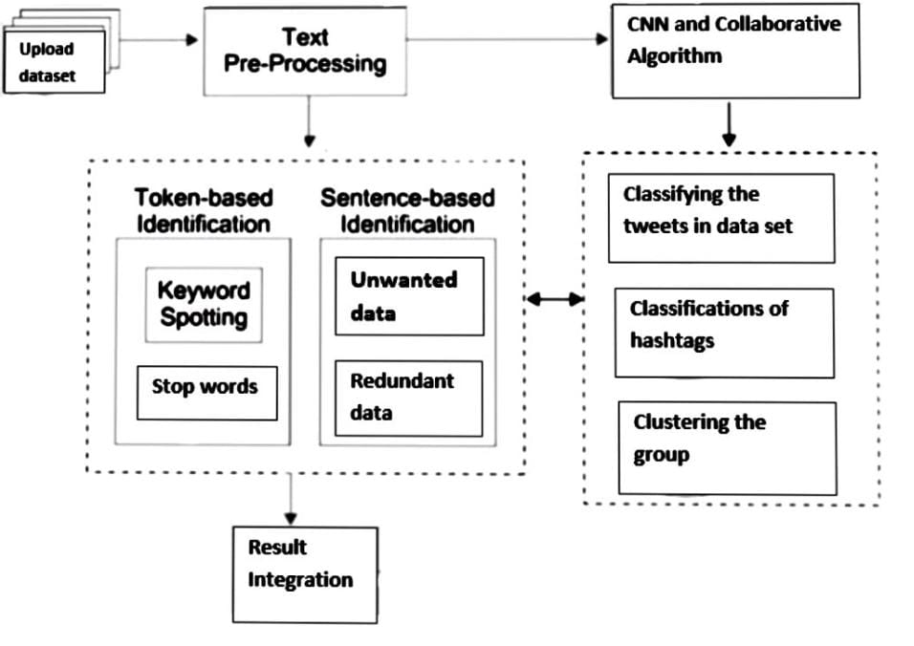
SYSTEM ARCITECTURE
ADMIN

Slide 13
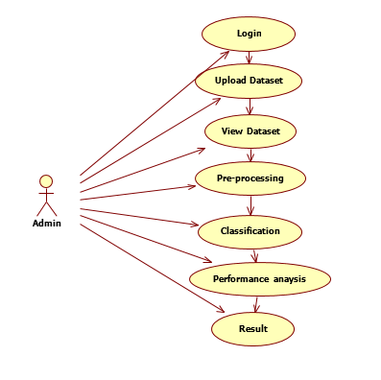
SYSTEM DESIGN
USE CASE DIAGRAM

Slide 14
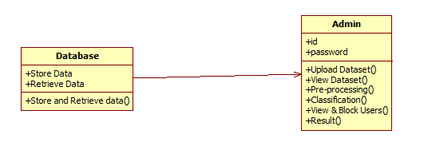
CLASS DIAGRAM

Slide 15
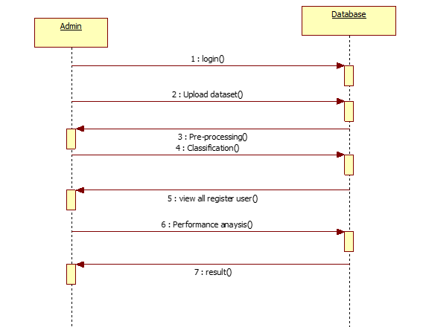
SEQUENCE DIAGRAM

Slide 16
DEPLOYMENT DIAGRAM

Slide 17
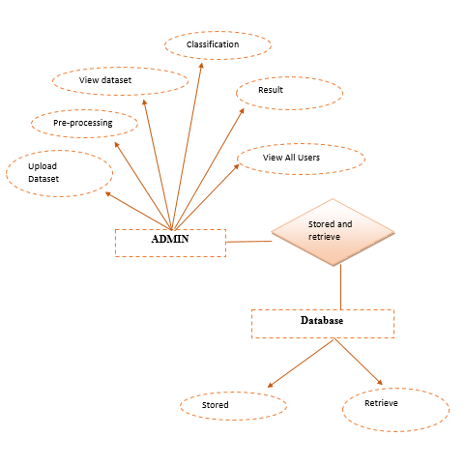
ER Diagram:

Slide 18
DETAILED EXPLANATION OF MODULES :
MODULE DESINGSPECIFICATION
In this project only one module:
ADMIN:
To provide following features-
Register into our system.
Login to our System.
Only Authorized Admin can access to our System.
Upload Related Dataset to Our System.
Data pre-processing process takes place like (stop-word removal, Stemming, Tokenization) to remove the unwanted data.

Slide 19
Classification of hash tags – Using Collaborative algorithm and CNN Algorithm classification of the hash tag takes place.
Feature extraction - To predict the tweets keyword in which type of group Based on the username.
Group Recommendation -To calculate Betweens value which means the users who is in more than one group. Classify the tweets in datasets into the groups by using Collaborative Filtering algorithm.
Remove all the redundant data.
Clustering the group by using CNN algorithm.
Performance Analysis - To calculate the Algorithm accuracy by using Confusion matrix.
Result- Generate the graph based on the number of tweets in each group.

Slide 20
TESTING AND PERFORMANCE ANALYSIS:
TESTING:
UNIT TESTING:
Unit testing is usually conducted as part of a combined code and unit test phase of the software life cycle, although it is not uncommon for coding and unit testing to be conducted as two distinct phases.
INTEGRATIONTESTING:
Software integration testing is the incremental integration testing of two or more n integrated software components on a single platform to produce failures caused by interface defects.
The task of the integration test is to check that components or software applications, e.g. components in a software system or – one step up – software applications at the company level – interact without error.
Test Results: All the test cases mentioned above passed successfully. No defects encountered.

Slide 21
ACCEPTANCETESTING:
User Acceptance Testing is a critical phase of any project and requires significant participation by the end user. It also ensures that the system meets the functional requirements.
Test Results: All the test cases mentioned above passed successfully. No defects encountered.
PERFORMANCE ANALYSIS:
1.Test Case Name: Data Collection and Uploading
Test Case Description: Twitter Datasets are collected which contains name of the user, time and date of the tweet and user tweets. Then the Dataset is uploaded successfully.
Step 1
Step Description:
Dataset Uploaded to the system as Admin.
Expected Result:
Dataset uploaded successfully by the admin.

Slide 22
2. Test Case Name: Data Preprocessing
Test Case Description :The Uploaded dataset is given as input for preprocessing step.
In this step uploaded dataset is preprocessed by removing the unwanted data.
Step 1
Step Description:
Remove Stop words like is, was, and, the etc.
Expected Result:
Stop words are removed successfully
Step 2
Step Description:
Stemming technique is applied to make the word composite
Expected Result:
Dataset is stemmed successfully

Slide 23
3.Test Case Name: Modeling Social Graph
Test Case Description: From the preprocessed dataset, each community has been classified by using the collaborative filtering algorithm. Users are classified according to their community.
Step 1
Step Description:
Distance measured for the tweets and removed the replicating data
Expected Output:
Replicated data’s are removed
Step 2
Step Description:
Clustering of Nodes. After removing the replicated data’s, remaining tweets are clustered.
Expected Output:
Tweets are clustered successfully.
Step 3
Step Description: Betweens is calculated for each user tweets. User those who belongs to the same
community are detected
Expected Output:
Betweens is calculated successfully.

Slide 24
Step 4
Step Description:
By using collaborative filtering algorithm, communities are classified.
Expected Output:
Communities are classified into cinema, sports and news.
4. Test Case Name: Content Analysis
Test Case Description: Tf/Idf Algorithm is implemented and rank is calculated for each community and overall rank is calculated.
Step 1
Step Description:
Redundant Data is removed by person correlation method
Expected Output:
Unnecessary data is removed.

Slide 25
Step 2
Step Description:
Using TF/IDF Algorithm, score is calculated
Expected Output:
For Each tweets tf/idf score is calculated
Step 3
Step Description:
Rank is calculated for each community. For the classified community, the rank is calculated based on number of tweets.
Expected Output:
Rank for each community is calculated.
Step4
Step Description:
From the output step 3, the overall rank is calculated by comparing the three communities
Expected Output:
Overall Rank is calculated and output says that the particular community (result) only used by many users.

Slide 26
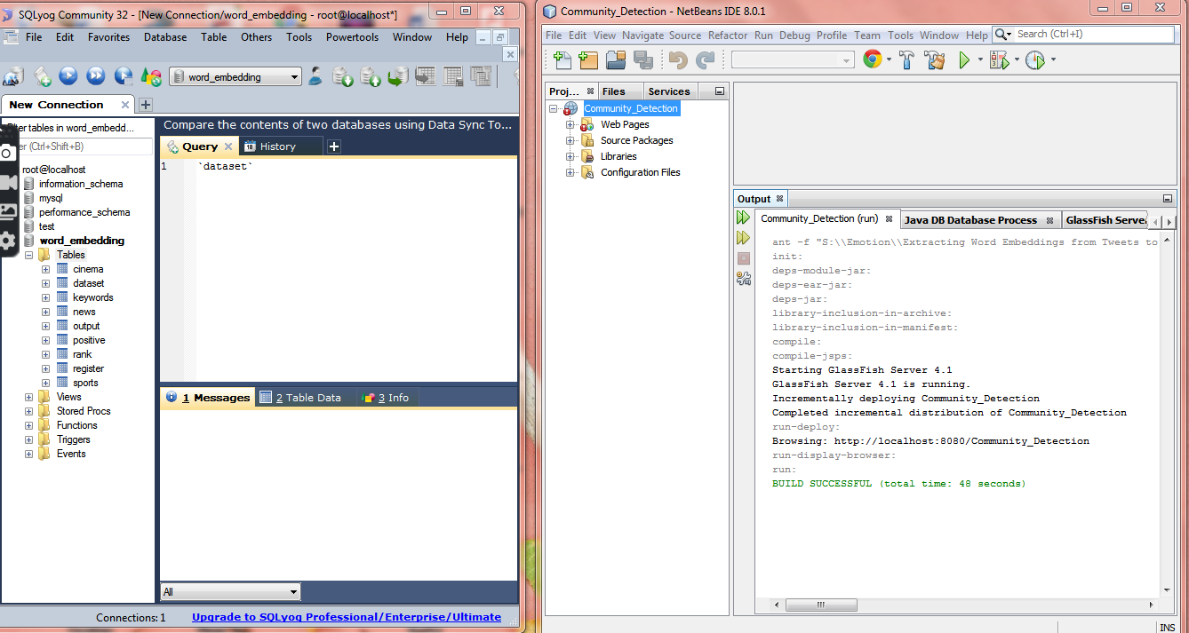
SCREENSHOTS
NETBEANS AND MY SQL

Slide 27

FIRST PAGE

Slide 28
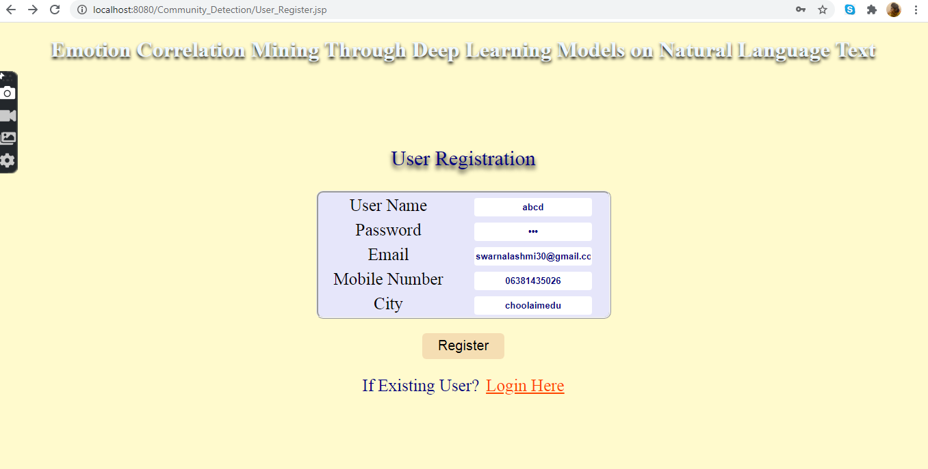
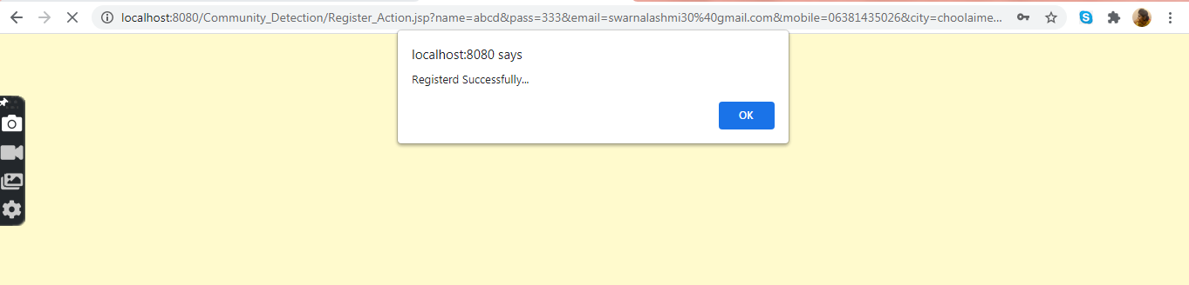
USER REGISTRATION

Slide 29
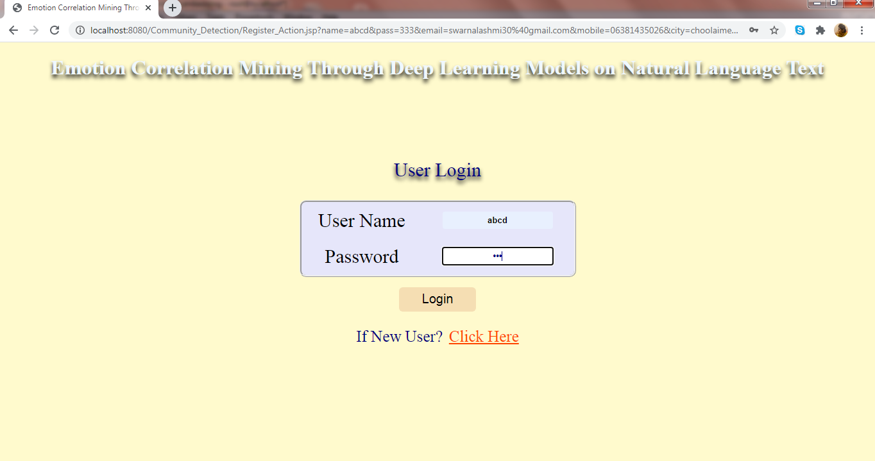
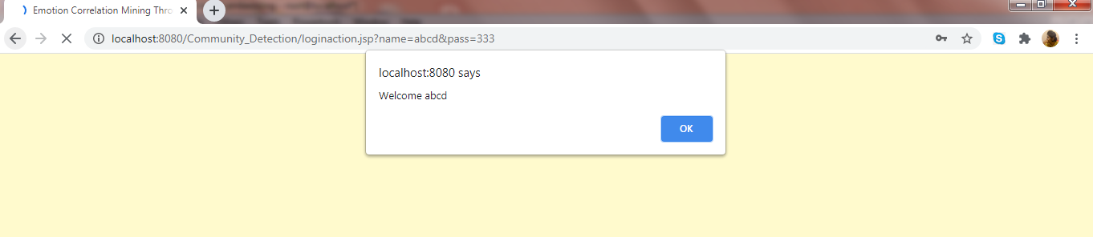
LOGIN PAGE

Slide 30
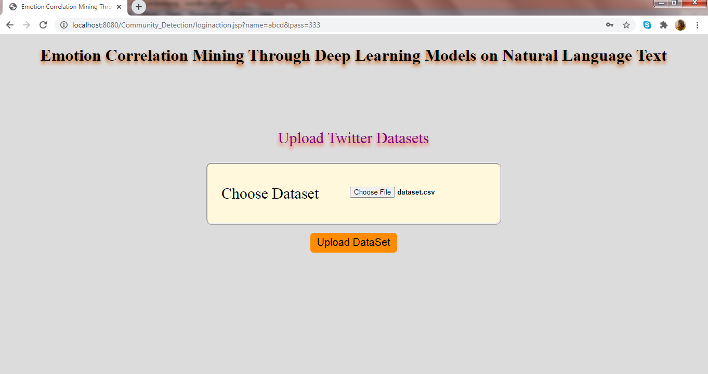

UPLOAD DATASET

Slide 31
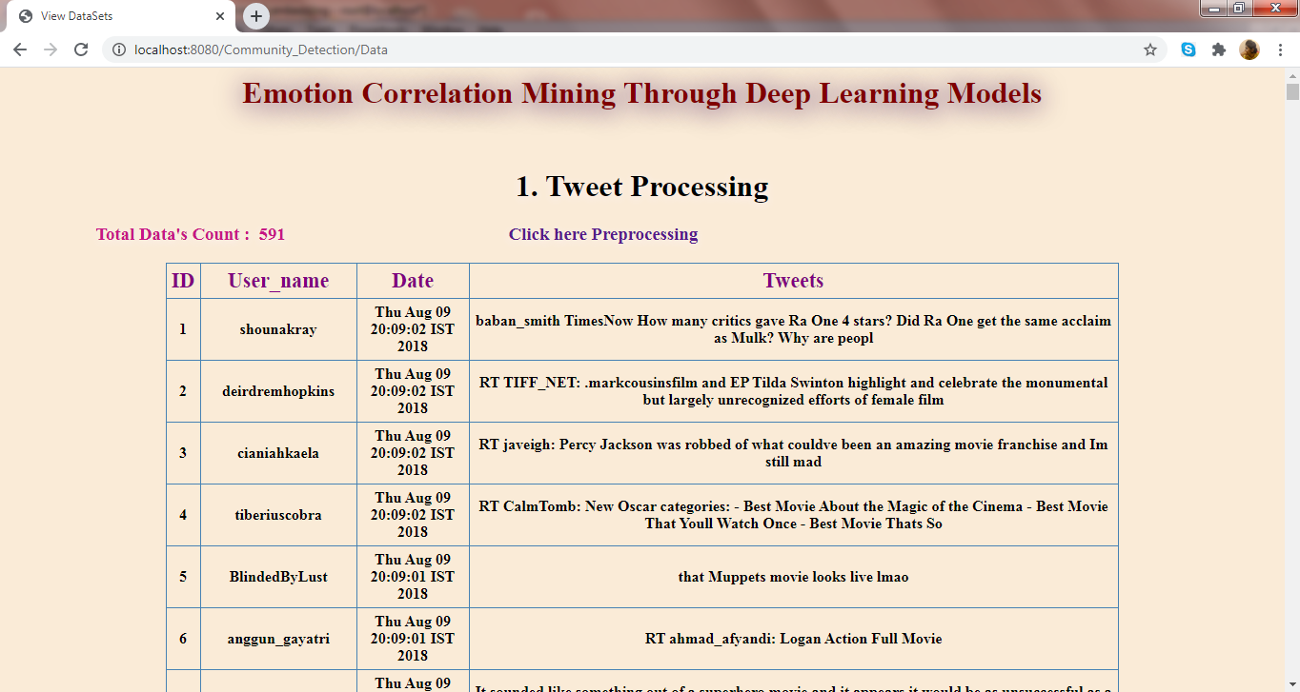
TWEET PROCESSING

Slide 32
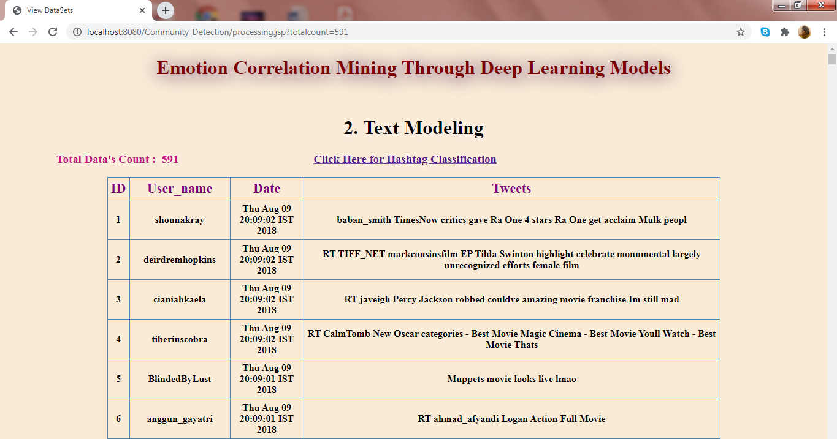
TEXT MODELLING

Slide 33
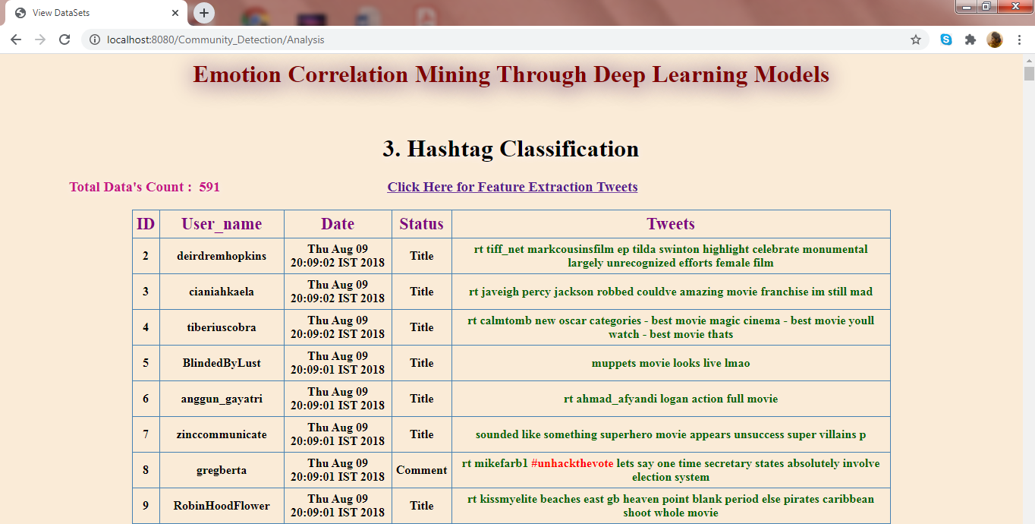
HASHTAG CLASSIFICATION

Slide 34
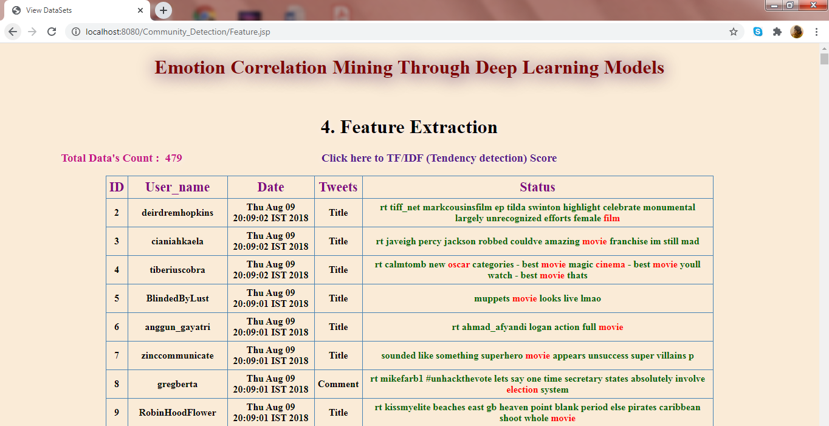
FEATURE EXTRACTION

Slide 35
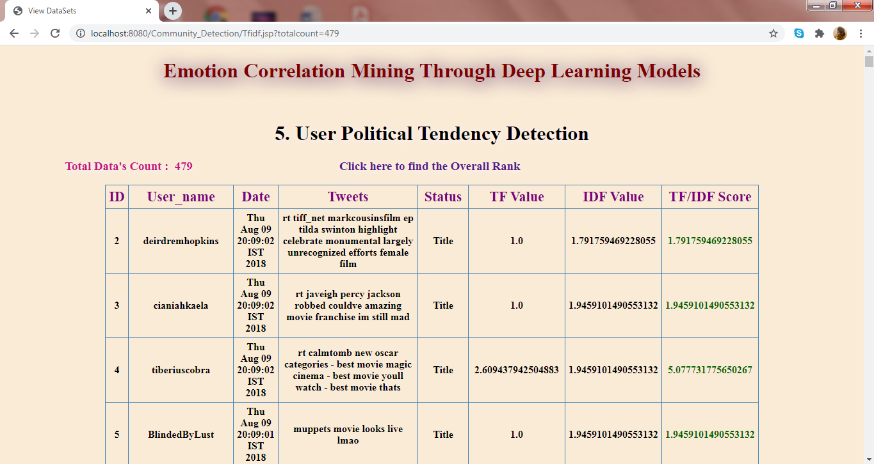
USER POLITICAL TENDANCY DETECTION

Slide 36
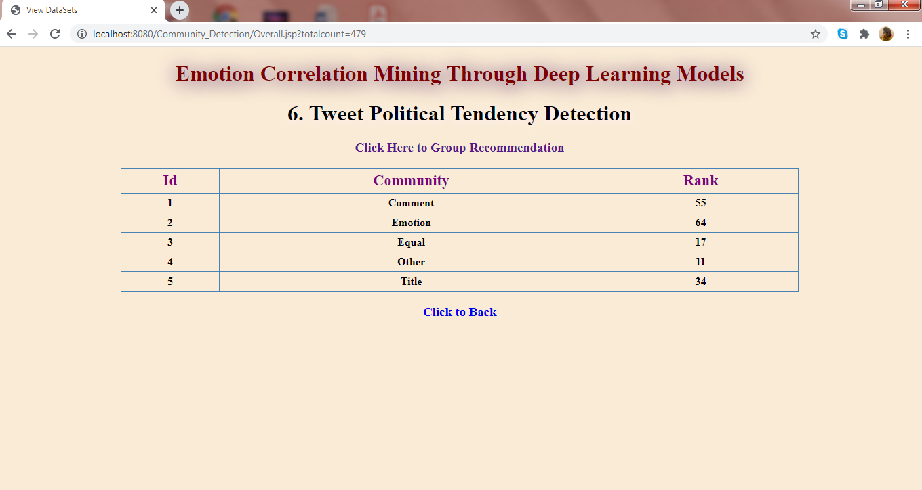
TWEET POLITICAL TENDENCY DETECTION

Slide 37
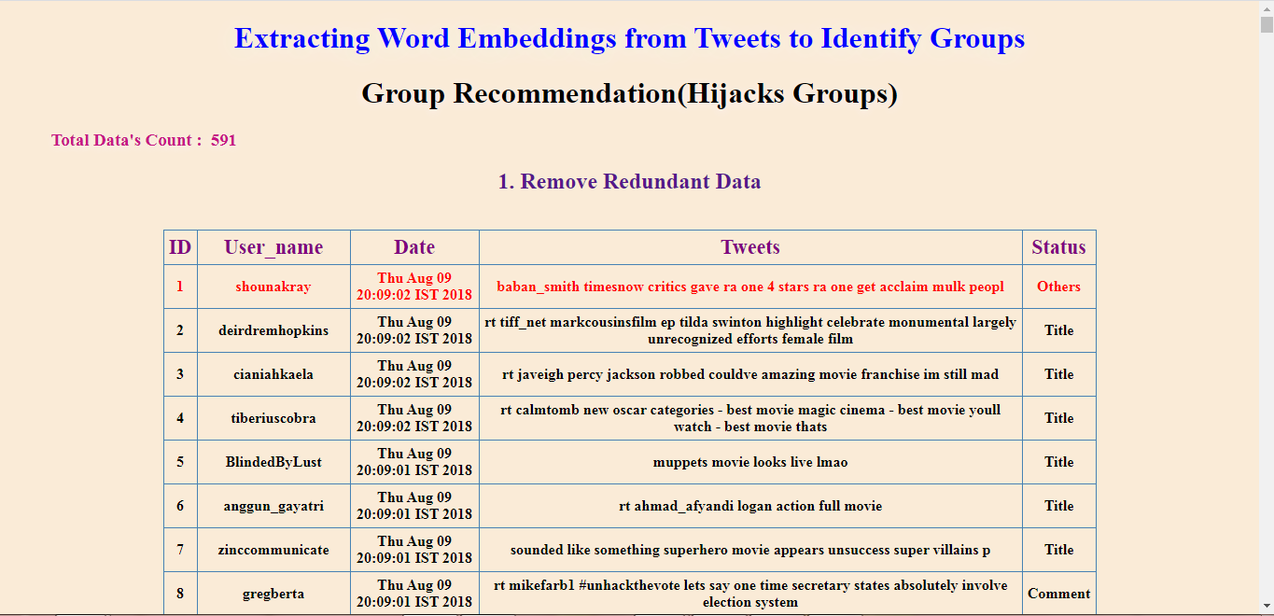
GROUP RECOMMENDATION

Slide 38
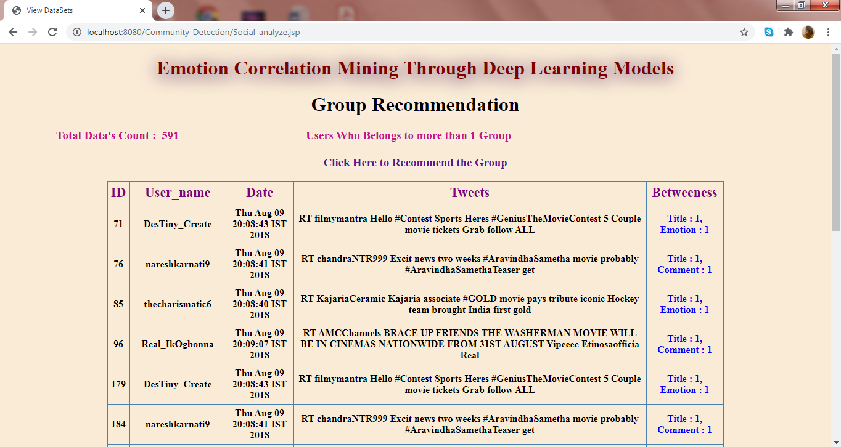
GROUP RECOMMENDATION USING BETWEENESS

Slide 39
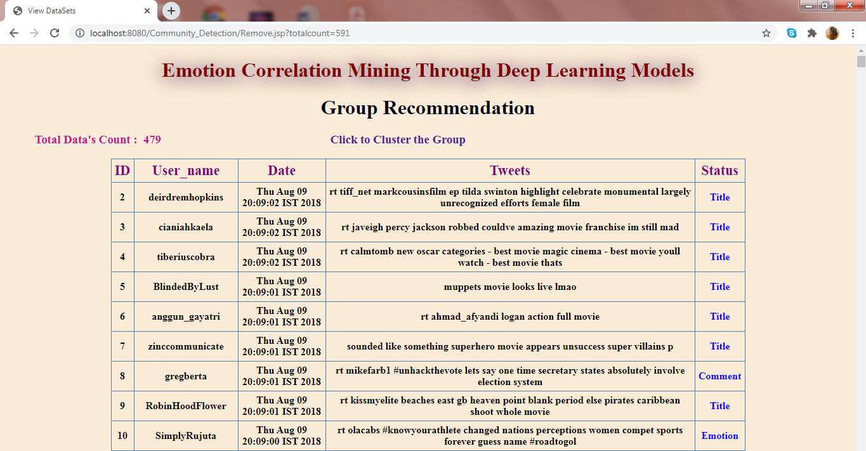
RECOMMENDING THE GROUP

Slide 40
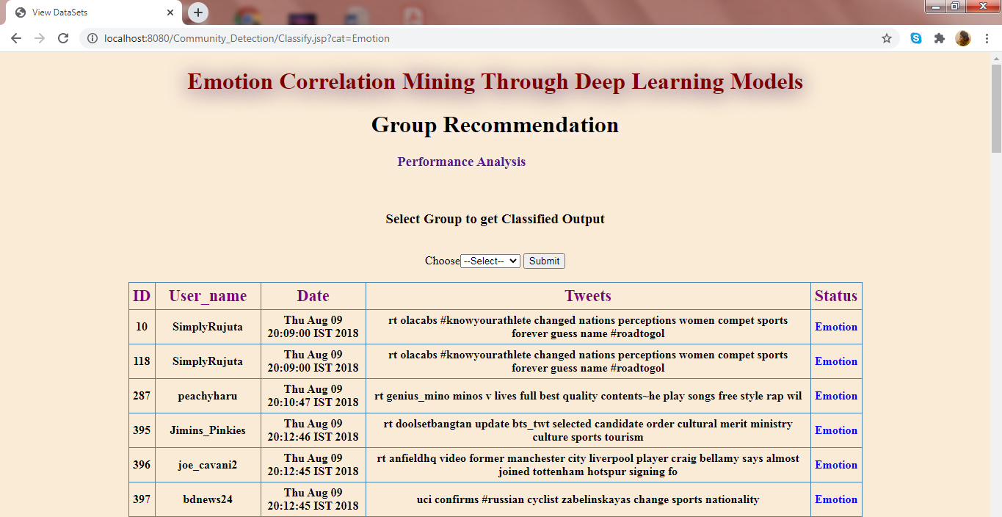
CLUSTERING THE GROUP

Slide 41
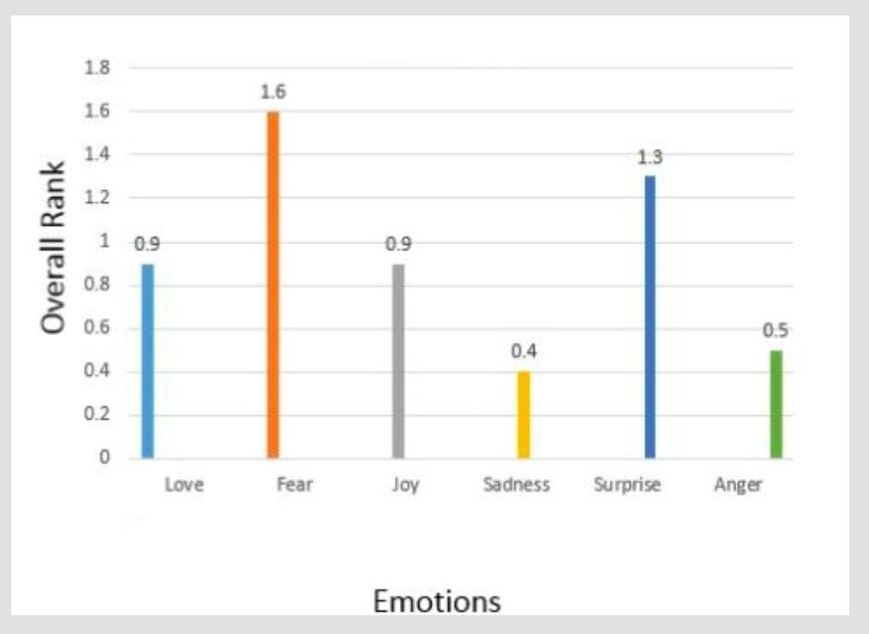
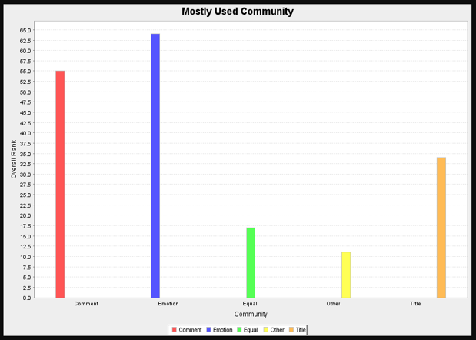
GRAPH COMPARISON
GRAPH OF EXISTING SYSTEM
GRAPH OF PROPOSED SYSTEM

Slide 42
CONCLUSION
This article mines the correlation of emotions based on the emotion recognition result of state-of-the- art deep learning models.
The errors caused by the dataset and models are cut down by designing three kinds of features and two deep neural-network models.
The emotion correlation is mined through an emotion confusion law, which is undirected, and an emotion evolution law, which is directed.

Slide 43
REFERENCES:
A. Ali, S. Ghaderi, and S. Sohrabkhani. Forecasting electrical consumptionby integration of neural network, time series and anova. Applied Mathematics and Computation, 186(2):1753–1761,2007.
C. Alzate, M. Espinoza, M. De, and J. Suykens. Identifying customer profiles in power load time series using spectral clustering. In Proceedings of International Conference on Artificial Neural Networks, pages 315–324. Springer,2009.
C. Alzate and M. Sinn. Improved electricity load forecasting via kernel spectral clustering of smart meters. In Proceedings of IEEE 13th International Conference on Data Mining, pages 943–948. IEEE,2013
X. Wang, X. Luo, and J. Chen, “Social sentiment detection of event via microblog,” in Proc. IEEE Int. Conf. Comput. Sci. Eng., 2013, pp.1051–1058.
C. Strapparava and A. Valitutti, “WordNet affect: An affective extension of WordNet,” in Proc. LREC, vol. 4, 2004, p. 40.

Slide 44
J. Staiano and M. Guerini, “DepecheMood: A lexicon for emotion analysis from crowd-annotated news,” 2014. [Online]. Available:arXiv:1405.1605.
F. Strack and R. Deutsch, “The duality of everyday life: Dual-process and dual system models in social psychology,” in APA Handbook of Personality and Social Psychology, vol. 1. Washington, DC, USA: Amer. Psychol. Assoc., 2015, pp. 891–927.
G. Badaro, H. Jundi, H. M. Hajj, and W. El-Hajj, “EmowordNet: Automatic expansion of emotion lexicon using English WordNet,” in Proc. 7th Joint Conf. Lexical Comput. Semantics, 2018, pp.86–93
S. Mohammad, F. Bravo-Marquez, M. Salameh, and S. Kiritchenko, “SemEval-2018 task 1: Affect in tweets,” in Proc. 12th Int. Workshop Semantic Eval., 2018, pp.1–17.
G. Badaro et al., “EMA at SemEval-2018 task 1: Emotion mining for Arabic,” in Proc. 12th Int. Workshop Semantic Eval., 2018, pp.236–244.

